Slide 1
Intro to Neural Networks
Slides credit:
Naheed Akhtar (SP19-PCS-009)
Dr. M. Aksam Iftikhar (Associate Professor, CS)

Slide 2
What are Neural Networks ?
An inspiration from biological neural systems, the most robust learning systems we know.
Attempt to understand natural biological systems through computational modeling.
Massive parallelism allows for computational efficiency.
Neurons are nerve cells that transmit signals to and from brains at the speed of around 200mph.
Each neuron cell communicates to anywhere from 1000 to 10,000 other neurons, muscle cells, glands, so on
Have around 10¹⁰ neurons in our brain (network of neurons)

Slide 3
What are Neural Networks ?
Neural Netwok is one of the most important learning algorithm in ML.
The learned classification model is an algebraic function (or a set of functions), rather than a boolean function, as for DTrees.
The function is linear for Perceptron algorithm, non-linear for Backpropagation algorithm
Both features and the output class are allowed to be real valued (rather than discrete)

Slide 4
Main components of a neuron Cell body: which holds DNA information in nucleus Dendrites: may have thousands of dendrites, usually short Axon: long structure, which splits in possibly thousands branches at the end. May be up to 1 meter long
Processor: Signals are processed by the cell body
Input : neuron collects signals from other neurons through dendrites
Output: Neuron fires (sends signal or spike of electrical activity to axon) if weighted sum of input is >threshold

Slide 5
Brain vs computer
Neurons have a “switching time” on the order of a few milliseconds, compared to nano/picoseconds for current computing hardware.
However, neural systems can perform complex cognitive tasks (vision, speech understanding) in tenths of a second, computers can’t.
Neural computation in humans exploits“massive parallelism”, computers are modular and serial.
Processing speed is not fixed in the brain, there is no system clock.
Synapses are far more complex (electrochemical) than computer logic gates (electrical)

Slide 6
Neural Network Learning
Learning approach of NN algorithm based on modeling while learning in biological neural systems is based on adaptation.
Two main algorithms:
Perceptron: Initial algorithm for learning simple neural networks (with no hidden layer) developed in the 1950’s.
Backpropagation: More complex algorithm for learning multi-layer neural networks developed in the 1980’s.

Slide 7
Types of Artificial Neural Networks
ANN can be categorized based on number of hidden layers contained in ANN architecture
01
Two Layer Neural Network (Perceptron)
Contains 0 hidden layers
Multi Layer Neural Network
Regular Neural Network
Contains 1 hidden layer
Deep Neural Network
Contains >1 hidden layers
02

Slide 8
Two layer Artificial Neural Network (Perceptron)
Multiple input nodes
Single output node
Takes weighted sum of the inputs
Unit function calculates the output for the network
x₁
w₁
x₂
w₂
∑ ?
ŷ
w₃
x₃
w_{n}
x_{n}

Slide 9
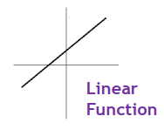
Unit Function
Linear Function
Simply output the weighted sum

Slide 10
Perceptron Example
To categorize a 2x2 pixel binary image to:
“Bright” and “Dark”
The rule is:
If it contains 2, 3 or 4 white pixels, it is “bright”
If it contains 0 or 1 white pixels, it is “dark”
Perceptron architecture:
Four input units, one for each pixel
One output unit: +1 for bright, -1 for dark
Image of 4 pixels

Slide 11
Perceptron Example
Input will be given at each neuron and weights are initialized with random values
Pixel 1
x₁
0.25
+1 Bright
If S> -0.1
Pixel 2
x₂
0.25
S
ŷ
0.25
Pixel 3
x₃
0.25
Otherwise
-1 Dark
x₄
Pixel 4
Weighted sum is calculated as:
S= 0.25*x₁ + 0.25*x₂ + 0.25*x₃ + 0.25*x₄

Slide 12
Perceptron Example
Consider an input, the weighted sum is calculate and prediction of perceptron is given below:
Calculation (Step-1):
X₁ = 1
X₂ = 0
X₃ = 0
X₄ = 0
S= 0.25*(1) + 0.25* (0) + 0.25*(0) + 0.25* (0) = 0.25
0.25 > 0, so the output of ANN is +1
So the image is categorized as “Bright”
Target : “Dark”
1
x₁
0.25
+1 Bright
If S> 0
0
x₂
0.25
S
ŷ
0.25
0
x₃
0.25
Otherwise
-1 Dark
x₄
0

Slide 13
Perceptron Training Rule (How to update weights)
When t(E) is different from o(E)
Add ∆_{i} to weight w_{i}
Where ∆_{i} = ɳ(t(E) – o(E) ) x_{i} → ɳ is learning rate (Usually very small value)
Do this for every weight in the network
Let ɳ=0.1
Calculating the error values
Calculating the New Weights
∆₁ = ɳ (t(E) – o(E) )* x₁
= 0.1 ( -1-1) * 1 = -0.2
wʹ₁ = w₁ +∆₁ = 0.25 - 0.2 = 0.05
∆₂ = ɳ (t(E) – o(E) )* x₂
= 0.1 ( -1-1) * 0 = 0
wʹ₂ = w₂ +∆₂ = 0.25 + 0 = 0.25
∆₃ = ɳ (t(E) – o(E) )* x₃
= 0.1 ( -1-1) * 1 = 0
wʹ₃ = w₃ +∆₃ = 0.25 + 0 = 0.25
∆₄ = ɳ (t(E) – o(E) )* x₄
= 0.1 ( -1-1) * 1 = 0
wʹ₄ = w₄ +∆₄ = 0.25 + 0 = 0.25

Slide 14
Perceptron Example
Weighted sum with updated weights is calculated and prediction of perceptron is given below:
Calculation (Step-2):
X₁ = 1
X₂ = 0
X₃ = 0
X₄ = 0
S= 0.05*(1) + 0.25* (0) + 0.25*(0) + 0.25* (0) = 0.05
0.05 > 0, so the output of ANN is +1
So the image is categorized as “Bright”
Target : “Dark”
1
x₁
0.05
+1 Bright
If S> 0
0
x₂
0.25
S
ŷ
0.25
0
x₃
0.25
Otherwise
-1 Dark
0
x₄

Slide 15
Perceptron Training Rule (How to update weights)
When t(E) is different from o(E)
Add ∆_{i} to weight w_{i}
Where ∆_{i} = ɳ(t(E) – o(E) ) x_{i} → ɳ is learning rate (Usually very small value)
Do this for every weight in the network
Let ɳ=0.1
Calculating the error values
Calculating the New Weights
∆₁ = ɳ (t(E) – o(E) )* x₁
= 0.1 ( -1 -1 ) * 1 = -0.2
wʹ₁ = w₁ +∆₁ = 0.05 - 0.2 = - 0.15
∆₂ = ɳ (t(E) – o(E) )* x₂
= 0.1 ( -1-1) * 0 = 0
wʹ₂ = w₂ +∆₂ = 0.25 + 0 = 0.25
∆₃ = ɳ (t(E) – o(E) )* x₃
= 0.1 ( -1-1) * 1 = 0
wʹ₃ = w₃ +∆₃ = 0.25 + 0 = 0.25
∆₄ = ɳ (t(E) – o(E) )* x₄
= 0.1 ( -1-1) * 1 = 0
wʹ₄ = w₄ +∆₄ = 0.25 + 0 = 0.25

Slide 16
Perceptron Example
Calculation (Step-3):
X₁ = 1
X₂ = 0
X₃ = 0
X₄ = 0
S= - 0.15*(1) + 0.25* (0) + 0.25*(0) + 0.25* (0) = - 0.15
- 0.15 < 0, so the output of ANN is +1
So the image is categorized as “Dark”
Target : “Dark”
1
x₁
-0.15
+1 Bright
If S> 0
0
x₂
0.25
S
ŷ
0.25
0
x₃
0.25
Otherwise
-1 Dark
x₄
0

Slide 17
Why Bias is Required….?

Slide 18
Example (AND)
To understand the requirement of bias, we consider an example of logical AND.
X₁ | X₂ | X₁ AND X₂
0 | 0 | 0
0 | 1 | 0
1 | 0 | 0
1 | 1 | 1
If S > 0
+1 ON
0
x₁
W₁=0.5
S
ŷ
W₂=0.5
1
x₂
-1 OFF
Each step in table represents the updated weights of highlighted example, until target output matches the observed output.
X1 = 0
X2 = 1,
ɳ = 0.1
t(E) = -1
Weights | Step-1 | Step-2 | Step-3 | Step-4
w1 | 0.5 | 0.5 | 0.5 | 0.5
w2 | 0.5 | 0.3 | 0.1 | -0.1
Weighted Sum | 0.5 | 0.3 | 0.1 | -0.1
Observed Output | +1 | +1 | +1 | -1

Slide 19
Example (AND)
Consider next example and perceptron is initialized from the fine tuned weights of previous example.
X₁ | X₂ | X₁ AND X₂
0 | 0 | 0
0 | 1 | 0
1 | 0 | 0
1 | 1 | 1
If S > 0
+1 ON
0
x₁
0.5
S
ŷ
-0.1
1
x₂
-1 OFF
Each step in table represents the updated weights of highlighted example, until target output matches the observed output.
X1 = 1
X2 = 0,
ɳ = 0.1
t(E) = -1
Weights | Step-1 | Step-2 | Step-3 | Step-4
w1 | 0.5 | 0.3 | 0.1 | -0.1
w2 | -0.1 | -0.1 | -0.1 | -0.1
Weighted Sum | 0.5 | 0.3 | 0.1 | -0.1
Observed Output | +1 | +1 | +1 | -1

Slide 20
Example (AND)
X₁ | X₂ | X₁ AND X₂
0 | 0 | 0
0 | 1 | 0
1 | 0 | 0
1 | 1 | 1
If S > 0
+1 ON
0
x₁
-0.1
S
ŷ
-0.1
1
x₂
-1 OFF
X1 = 1
X2 = 1,
ɳ = 0.1
t(E) = +1
Weights | Step-1 | Step-2
w1 | -0.1 | 0.1
w2 | -0.1 | 0.1
Weighted Sum | -0.2 | 0.2
Observed Output | - 1 | +1

Slide 21
Example (AND)
After one Epoch, we get the final weights as shown in figure.
We cannot get fine tune weights even after many epochs, that satisfied all examples of logical AND.
The solution of this problem is to introduce Bias.
If S > 0
+1 ON
0
x₁
0.1
S
ŷ
0.1
1
x₂
-1 OFF

Slide 22
Use of Bias
Bias
x₀
Bias is just like an intercept added in a linear equation.
If S > 0
+1 ON
0
x₁
0.5
S
ŷ
0.5
output = sum (weights * inputs) + bias
1
x₂
-1 OFF
The output is calculated by multiplying the inputs with their weights and then passing it through an activation function like the Sigmoid function, etc. Here, bias acts like a constant which helps the model to fit the given data.

Slide 23
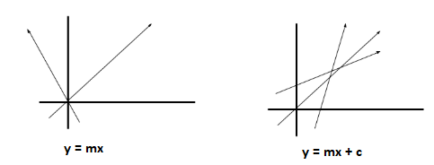
Use of Bias
A simpler way to understand bias is through a constant c of a linear function
y =mx + c
It allows us to move the line down and up fitting the prediction with the data better. If the constant c is absent then the line will pass through the origin (0, 0) and we will get a poorer fit.

Slide 24
Example (AND) with Bias
Bias
x₀=1
X₁ | X₂ | X₁ AND X₂
0 | 0 | 0
0 | 1 | 0
1 | 0 | 0
1 | 1 | 1
W₀=0.5
If S > 0
+1 ON
0
x₁
W₁=0.5
S
ŷ
W₂=0.5
1
x₂
-1 OFF
Each step in table represents the updated weights of highlighted example, until target output matches the observed output.
X1 = 0
X2 = 1,
ɳ = 0.1
t(E) = -1
Weights | Step-1 | Step-2 | Step-3 | Step-4
w0 | 0.5 | 0.3 | 0.1 | -0.1
w1 | 0.5 | 0.5 | 0.5 | 0.5
w2 | 0.5 | 0.3 | 0.1 | -0.1
Weighted Sum | 1 | 0.6 | 0.2 | -0.2
Observed Output | +1 | +1 | +1 | -1

Slide 25
Example (AND) with Bias
Bias
x₀=1
X₁ | X₂ | X₁ AND X₂
0 | 0 | 0
0 | 1 | 0
1 | 0 | 0
1 | 1 | 1
W₀=-0.1
If S > 0
+1 ON
0
x₁
W₁=0.5
S
ŷ
W₂=-0.1
1
x₂
-1 OFF
X1 = 1
X2 = 0,
ɳ = 0.1
t(E) = -1
Weights | Step-1 | Step-2
w0 | -0.1 | -0.3
w1 | 0.5 | 0.3
w2 | -0.1 | -0.1
Weighted Sum | 0.4 | 0
Observed Output | +1 | -1

Slide 26
Example (AND) with Bias
Bias
x₀=1
X₁ | X₂ | X₁ AND X₂
0 | 0 | 0
0 | 1 | 0
1 | 0 | 0
1 | 1 | 1
W₀=-0.3
If S > 0
+1 ON
0
x₁
W₁=0.3
S
ŷ
W₂=-0.1
1
x₂
-1 OFF
X1 = 1
X2 = 1,
ɳ = 0.1
t(E) = +1
Weights | Step-1 | Step-2
w0 | -0.3 | -0.1
w1 | 0.3 | 0.5
w2 | -0.1 | 0.1
Weighted Sum | 0 | 0.5
Observed Output | -1 | +1

Slide 27
Example (AND) with Bias
After two epochs, fine tune weights will be obtained, that will satisfy all training examples.
Bias
x₀=1
After 2 Epochs
W₀= - 0.3
If S > 0
+1 ON
X₁ | X₂ | X₁ AND X₂
0 | 0 | 0
0 | 1 | 0
1 | 0 | 0
1 | 1 | 1
0
x₁
W₁= 0.3
S
ŷ
W₂= 0.1
1
x₂
-1 OFF
Final Weights
X1 = 0
X2 = 1,
ɳ = 0.1
t(E) = -1
Weights
w0 | - 0.3
w1 | 0.3
w2 | 0.1

Slide 28
Training Regimes/Protocols

Slide 29
Training Regimes/Training Protocols
Three major training protocols:
1. Stochastic
Patterns/Examples are chosen randomly from the training set, and network weights are updated after every sample presentation.
2. Batch
Weights are update based on all samples, iterate weight update
3. Online
Each sample is presented only once, weight update after each sample presentation
Used when number of samples is so large it does not fit in the memory
Dependent on the order of sample presentation
Should be avoided when possible

Slide 30
Example of AND by taking Batch Regime (Without Bias)
To understand the requirement of bias, we consider an example of logical AND.
Epoch:1
If S > 0
+1 ON
X₁ | X₂ | X₁ AND X₂
0 | 1 | 0
0 | 1 | 0
1 | 0 | 0
1 | 1 | 1
0
x₁
W₁=0.5
S
ŷ
W₂=0.5
1
x₂
-1 OFF
Weights | Ex-1 x₁=0, x₂=1 | Ex-2 x₁=1, x₂=0 | Ex-3 x₁=1, x₂=1 | Ex-4 x₁=0, x₂=0
w1 | 0.5 | 0.5 | 0.5 | 0.5
w2 | 0.5 | 0.5 | 0.5 | 0.5
Weighted Sum | 0.5 | 0.5 | 1 | 0
Observed Output | +1 | +1 | +1 | -1
Target Output | -1 | -1 | +1 | -1
∆₁ (Error) | 0 | -0.2 | 0 | 0
∆₂ (Error) | -0.2 | 0 | 0 | 0
Total Error ∆₁ = 0 - 0.2+0+0 = - 0.2
Total Error ∆₂ = - 0.2+0+0+0 = - 0.2
Updated w1 = 0.5-0.2 = 0.3
Updated w2 = 0.5-0.2 = 0.3

Slide 31
Example of AND by taking Batch Regime (Without Bias)
To understand the requirement of bias, we consider an example of logical AND.
Epoch:1
If S > 0
+1 ON
X₁ | X₂ | X₁ AND X₂
0 | 1 | 0
0 | 1 | 0
1 | 0 | 0
1 | 1 | 1
0
x₁
W₁=0.5
S
ŷ
W₂=0.5
1
x₂
-1 OFF
Weights | Ex-1 x₁=0, x₂=1 | Ex-2 x₁=1, x₂=0 | Ex-3 x₁=1, x₂=1 | Ex-4 x₁=0, x₂=0
w1 | 0.5 | 0.5 | 0.5 | 0.5
w2 | 0.5 | 0.5 | 0.5 | 0.5
Weighted Sum | 0.5 | 0.5 | 1 | 0
Observed Output | +1 | +1 | +1 | -1
Target Output | -1 | -1 | +1 | -1
∆₁ (Error) | 0 | -0.2 | 0 | 0
∆₂ (Error) | -0.2 | 0 | 0 | 0
After 1-Epoch, two examples are correctly classified
Total Error ∆₁ = 0 - 0.2+0+0 = - 0.2
Total Error ∆₂ = - 0.2+0+0+0 = - 0.2
Updated w1 = 0.5-0.2 = 0.3
Updated w2 = 0.5-0.2 = 0.3

Slide 32
Example of AND by taking Batch Regime (Without Bias)
Epoch:2
If S > 0
+1 ON
X₁ | X₂ | X₁ AND X₂
0 | 1 | 0
0 | 1 | 0
1 | 0 | 0
1 | 1 | 1
0
x₁
W₁=0.3
S
ŷ
W₂=0.3
1
x₂
-1 OFF
Weights | Ex-1 x₁=0, x₂=1 | Ex-2 x₁=1, x₂=0 | Ex-3 x₁=1, x₂=1 | Ex-4 x₁=0, x₂=0
w1 | 0.3 | 0.3 | 0.3 | 0.3
w2 | 0.3 | 0.3 | 0.3 | 0.3
Weighted Sum | 0.3 | 0.3 | 0.6 | 0
Observed Output | +1 | +1 | +1 | -1
Target Output | -1 | -1 | +1 | -1
∆₁ | 0 | -0.2 | 0 | 0
∆₂ | -0.2 | 0 | 0 | 0
Total Error ∆₁ = 0 - 0.2+0+0 = - 0.2
Total Error ∆₂ = - 0.2+0+0+0 = - 0.2
Updated w1 = 0.3-0.2 = 0.1
Updated w2 = 0.3-0.2 = 0.1

Slide 33
Example of AND by taking Batch Regime (Without Bias)
Epoch:2
If S > 0
+1 ON
X₁ | X₂ | X₁ AND X₂
0 | 1 | 0
0 | 1 | 0
1 | 0 | 0
1 | 1 | 1
0
x₁
W₁=0.3
S
ŷ
W₂=0.3
1
x₂
-1 OFF
Weights | Ex-1 x₁=0, x₂=1 | Ex-2 x₁=1, x₂=0 | Ex-3 x₁=1, x₂=1 | Ex-4 x₁=0, x₂=0
w1 | 0.3 | 0.3 | 0.3 | 0.3
w2 | 0.3 | 0.3 | 0.3 | 0.3
Weighted Sum | 0.3 | 0.3 | 0.6 | 0
Observed Output | +1 | +1 | +1 | -1
Target Output | -1 | -1 | +1 | -1
∆₁ | 0 | -0.2 | 0 | 0
∆₂ | -0.2 | 0 | 0 | 0
Total Error ∆₁ = 0 - 0.2+0+0 = - 0.2
Total Error ∆₂ = - 0.2+0+0+0 = - 0.2
Updated w1 = 0.3-0.2 = 0.1
Updated w2 = 0.3-0.2 = 0.1

Slide 34
Example of AND by taking Batch Regime (Without Bias)
Epoch:3
If S > 0
+1 ON
X₁ | X₂ | X₁ AND X₂
0 | 1 | 0
0 | 1 | 0
1 | 0 | 0
1 | 1 | 1
0
x₁
W₁=0.1
S
ŷ
W₂=0.1
1
x₂
-1 OFF
Weights | Ex-1 x₁=0, x₂=1 | Ex-2 x₁=1, x₂=0 | Ex-3 x₁=1, x₂=1 | Ex-4 x₁=0, x₂=0
w1 | 0.1 | 0.1 | 0.1 | 0.1
w2 | 0.1 | 0.1 | 0.1 | 0.1
Weighted Sum | 0.1 | 0.1 | 0.2 | 0
Observed Output | +1 | +1 | +1 | -1
Target Output | -1 | -1 | +1 | -1
∆₁ | 0 | -0.2 | 0 | 0
∆₂ | -0.2 | 0 | 0 | 0
Total Error ∆₁ = 0 - 0.2+0+0 = - 0.2
Total Error ∆₂ = - 0.2+0+0+0 = - 0.2
Updated w1 = 0.1-0.2 = - 0.1
Updated w2 = 0.1-0.2 = - 0.1

Slide 35
Example of AND by taking Batch Regime (Without Bias)
Epoch:3
If S > 0
+1 ON
X₁ | X₂ | X₁ AND X₂
0 | 1 | 0
0 | 1 | 0
1 | 0 | 0
1 | 1 | 1
0
x₁
W₁=0.1
S
ŷ
W₂=0.1
1
x₂
-1 OFF
Weights | Ex-1 x₁=0, x₂=1 | Ex-2 x₁=1, x₂=0 | Ex-3 x₁=1, x₂=1 | Ex-4 x₁=0, x₂=0
w1 | 0.1 | 0.1 | 0.1 | 0.1
w2 | 0.1 | 0.1 | 0.1 | 0.1
Weighted Sum | 0.1 | 0.1 | 0.2 | 0
Observed Output | +1 | +1 | +1 | -1
Target Output | -1 | -1 | +1 | -1
∆₁ | 0 | -0.2 | 0 | 0
∆₂ | -0.2 | 0 | 0 | 0
Total Error ∆₁ = 0 - 0.2+0+0 = - 0.2
Total Error ∆₂ = - 0.2+0+0+0 = - 0.2
Updated w1 = 0.1-0.2 = - 0.1
Updated w2 = 0.1-0.2 = - 0.1

Slide 36
Example of AND by taking Batch Regime (Without Bias)
Epoch:4
If S > 0
+1 ON
X₁ | X₂ | X₁ AND X₂
0 | 1 | 0
0 | 1 | 0
1 | 0 | 0
1 | 1 | 1
0
x₁
W₁=-0.1
S
ŷ
W₂=-0.1
1
x₂
-1 OFF
Weights | Ex-1 x₁=0, x₂=1 | Ex-2 x₁=1, x₂=0 | Ex-3 x₁=1, x₂=1 | Ex-4 x₁=0, x₂=0
w1 | -0.1 | -0.1 | -0.1 | -0.1
w2 | -0.1 | -0.1 | -0.1 | -0.1
Weighted Sum | -0.1 | -0.1 | -0.2 | 0
Observed Output | -1 | -1 | -1 | -1
Target Output | -1 | -1 | +1 | -1
∆₁ | 0 | 0 | 0.2 | 0
∆₂ | 0 | 0 | 0.2 | 0
Total Error ∆₁ = 0 + 0.2+0+0 = 0.2
Total Error ∆₂ = 0.2+0+0+0 = 0.2
Updated w1 = -0.1+0.2 = +0.1
Updated w2 = -0.1+0.2 = +0.1

Slide 37
Example of AND by taking Batch Regime (Without Bias)
Epoch:4
If S > 0
+1 ON
X₁ | X₂ | X₁ AND X₂
0 | 1 | 0
0 | 1 | 0
1 | 0 | 0
1 | 1 | 1
0
x₁
W₁=-0.1
S
ŷ
W₂=-0.1
1
x₂
-1 OFF
Weights | Ex-1 x₁=0, x₂=1 | Ex-2 x₁=1, x₂=0 | Ex-3 x₁=1, x₂=1 | Ex-4 x₁=0, x₂=0
w1 | -0.1 | -0.1 | -0.1 | -0.1
w2 | -0.1 | -0.1 | -0.1 | -0.1
Weighted Sum | -0.1 | -0.1 | -0.2 | 0
Observed Output | -1 | -1 | -1 | -1
Target Output | -1 | -1 | +1 | -1
∆₁ | 0 | 0 | 0.2 | 0
∆₂ | 0 | 0 | 0.2 | 0
Total Error ∆₁ = 0 + 0.2+0+0 = 0.2
Total Error ∆₂ = 0.2+0+0+0 = 0.2
Updated w1 = -0.1+0.2 = +0.1
Updated w2 = -0.1+0.2 = +0.1

Slide 38
Example of AND by taking Batch Regime (Without Bias)
Epoch:5
If S > 0
+1 ON
X₁ | X₂ | X₁ AND X₂
0 | 1 | 0
0 | 1 | 0
1 | 0 | 0
1 | 1 | 1
0
x₁
W₁=0.1
S
ŷ
W₂=0.1
1
x₂
-1 OFF
Weights | Ex-1 x₁=0, x₂=1 | Ex-2 x₁=1, x₂=0 | Ex-3 x₁=1, x₂=1 | Ex-4 x₁=0, x₂=0
w1 | 0.1 | 0.1 | 0.1 | 0.1
w2 | 0.1 | 0.1 | 0.1 | 0.1
Weighted Sum | 0.1 | 0.1 | 0.2 | 0
Observed Output | +1 | +1 | +1 | -1
Target Output | -1 | -1 | +1 | -1
∆₁ | 0 | -0.2 | 0 | 0
∆₂ | -0.2 | 0 | 0 | 0
Total Error ∆₁ = 0 - 0.2+0+0 = - 0.2
Total Error ∆₂ = -0.2+0+0 = - 0.2
Updated w1 = 0.1-0.2 = - 0.1
Updated w2 = 0.1-0.2 = - 0.1

Slide 39
Example of AND by taking Batch Regime (Without Bias)
Epoch:5
If S > 0
+1 ON
X₁ | X₂ | X₁ AND X₂
0 | 1 | 0
0 | 1 | 0
1 | 0 | 0
1 | 1 | 1
0
x₁
W₁=0.1
S
ŷ
W₂=0.1
1
x₂
-1 OFF
Weights | Ex-1 x₁=0, x₂=1 | Ex-2 x₁=1, x₂=0 | Ex-3 x₁=1, x₂=1 | Ex-4 x₁=0, x₂=0
w1 | 0.1 | 0.1 | 0.1 | 0.1
w2 | 0.1 | 0.1 | 0.1 | 0.1
Weighted Sum | 0.1 | 0.1 | 0.2 | 0
Observed Output | +1 | +1 | +1 | -1
Target Output | -1 | -1 | +1 | -1
∆₁ | 0 | -0.2 | 0 | 0
∆₂ | -0.2 | 0 | 0 | 0
After 5-Epochs, two examples are correctly classified
Total Error ∆₁ = 0 - 0.2+0+0 = - 0.2
Total Error ∆₂ = -0.2+0+0 = - 0.2
Updated w1 = 0.1-0.2 = - 0.1
Updated w2 = 0.1-0.2 = - 0.1

Slide 40
Consider the Same example of AND (With Batch Regime) and Bias

Slide 41
Bias
AND with Bias (Batch Regime)
x₀
W0=0.5
If S > 0
+1 ON
0
x₁
W1=0.5
S
Epoch:1
W2=0.5
ŷ
-1 OFF
1
x₂
Weights | Ex-1 x₁=0, x₂=1 | Ex-2 x₁=1, x₂=0 | Ex-3 x₁=1, x₂=1 | Ex-4 x₁=0, x₂=0
w0 | 0.5 | 0.5 | 0.5 | 0.5
w1 | 0.5 | 0.5 | 0.5 | 0.5
w2 | 0.5 | 0.5 | 0.5 | 0.5
Weighted Sum | 1 | 1 | 1.5 | .5
Observed Output | +1 | +1 | +1 | +1
Target Output | -1 | -1 | +1 | -1
∆₀ | -0.2 | -0.2 | 0 | -0.2
∆₁ | 0 | -0.2 | 0 | 0
∆₂ | -0.2 | 0 | 0 | 0
Total Error ∆₀ = -.2 -.2+0-.2 = -0.6
Total Error ∆₁ = 0 - .2+0+0 = -0.2
Total Error ∆₂ = -.2+0+0+0 = -0.2
Updated w0 = 0.5-0.2 = -.1
Updated w1 = 0.5-0.2 = 0.3
Updated w2 = 0.5-0.2 = 0.3

Slide 42
Bias
AND with Bias (Batch Regime)
x₀
0.5
If S > 0
+1 ON
0
x₁
0.5
S
Epoch:1
0.5
ŷ
-1 OFF
1
x₂
Weights | Ex-1 x₁=0, x₂=1 | Ex-2 x₁=1, x₂=0 | Ex-3 x₁=1, x₂=1 | Ex-4 x₁=0, x₂=0
w0 | 0.5 | 0.5 | 0.5 | 0.5
w1 | 0.5 | 0.5 | 0.5 | 0.5
w2 | 0.5 | 0.5 | 0.5 | 0.5
Weighted Sum | 1 | 1 | 1.5 | .5
Observed Output | +1 | +1 | +1 | +1
Target Output | -1 | -1 | +1 | -1
∆₀ | -0.2 | -0.2 | 0 | -0.2
∆₁ | 0 | -0.2 | 0 | 0
∆₂ | -0.2 | 0 | 0 | 0
Total Error ∆₀ = -.2 -.2+0-.2 = -0.6
Total Error ∆₁ = 0 - .2+0+0 = -0.2
Total Error ∆₂ = -.2+0+0+0 = -0.2
Updated w0 = 0.5-0.2 = -.1
Updated w1 = 0.5-0.2 = 0.3
Updated w2 = 0.5-0.2 = 0.3

Slide 43
Bias
AND with Bias (Batch Regime)
x₀
-.1
If S > 0
+1 ON
0
x₁
0.3
S
Epoch:2
0.3
ŷ
-1 OFF
1
x₂
Weights | Ex-1 x₁=0, x₂=1 | Ex-2 x₁=1, x₂=0 | Ex-3 x₁=1, x₂=1 | Ex-4 x₁=0, x₂=0
w0 | -.1 | -.1 | -.1 | -.1
w1 | 0.3 | 0.3 | 0.3 | 0.3
w2 | 0.3 | 0.3 | 0.3 | 0.3
Weighted Sum | 0.2 | 0.2 | 0.5 | -0.1
Observed Output | +1 | +1 | +1 | -1
Target Output | -1 | -1 | +1 | -1
∆₀ | -0.2 | -0.2 | 0 | 0
∆₁ | 0 | -0.2 | 0 | 0
∆₂ | -0.2 | 0 | 0 | 0
Total Error ∆₀ = -.2 -.2+0+0 = -0.4
Total Error ∆₁ = 0 - .2+0+0 = -0.2
Total Error ∆₂ = -.2+0+0+0 = -0.2
Updated w0 = 0.5-0.2 = -.5
Updated w1 = 0.5-0.2 = 0.1
Updated w2 = 0.5-0.2 = 0.1

Slide 44
Bias
AND with Bias (Batch Regime)
x₀
-.1
If S > 0
+1 ON
0
x₁
0.3
S
Epoch:2
0.3
ŷ
-1 OFF
1
x₂
Weights | Ex-1 x₁=0, x₂=1 | Ex-2 x₁=1, x₂=0 | Ex-3 x₁=1, x₂=1 | Ex-4 x₁=0, x₂=0
w0 | -.1 | -.1 | -.1 | -.1
w1 | 0.3 | 0.3 | 0.3 | 0.3
w2 | 0.3 | 0.3 | 0.3 | 0.3
Weighted Sum | 0.2 | 0.2 | 0.5 | -0.1
Observed Output | +1 | +1 | +1 | -1
Target Output | -1 | -1 | +1 | -1
∆₀ | -0.2 | -0.2 | 0 | 0
∆₁ | 0 | -0.2 | 0 | 0
∆₂ | -0.2 | 0 | 0 | 0
Total Error ∆₀ = -.2 -.2+0+0 = -0.4
Total Error ∆₁ = 0 - .2+0+0 = -0.2
Total Error ∆₂ = -.2+0+0+0 = -0.2
Updated w0 = 0.5-0.2 = -.5
Updated w1 = 0.5-0.2 = 0.1
Updated w2 = 0.5-0.2 = 0.1

Slide 45
Bias
AND with Bias (Batch Regime)
x₀
-.5
If S > 0
+1 ON
0
x₁
0.1
S
Epoch:3
0.1
ŷ
-1 OFF
1
x₂
Weights | Ex-1 x₁=0, x₂=1 | Ex-2 x₁=1, x₂=0 | Ex-3 x₁=1, x₂=1 | Ex-4 x₁=0, x₂=0
w0 | -.5 | -.5 | -.5 | -.5
w1 | 0.1 | 0.1 | 0.1 | 0.1
w2 | 0.1 | 0.1 | 0.1 | 0.1
Weighted Sum | -0.4 | -0.4 | -0.3 | -0.3
Observed Output | -1 | -1 | -1 | -1
Target Output | -1 | -1 | +1 | -1
∆₀ | 0 | 0 | 0.2 | 0
∆₁ | 0 | 0 | 0.2 | 0
∆₂ | 0 | 0 | 0.2 | 0
Total Error ∆₀ = 0+0+.2+0 = 0.2
Total Error ∆₁ = 0+0+.2+0 = 0.2
Total Error ∆₂ = 0+0+.2+0 = 0.2
Updated w0 = -0.5+0.2 = - 0.3
Updated w1 = 0.1+0.2 = 0.3
Updated w2 = 0.1+0.2 = 0.3

Slide 46
Bias
AND with Bias (Batch Regime)
x₀
-.5
If S > 0
+1 ON
0
x₁
0.1
S
Epoch:3
0.1
ŷ
-1 OFF
1
x₂
Weights | Ex-1 x₁=0, x₂=1 | Ex-2 x₁=1, x₂=0 | Ex-3 x₁=1, x₂=1 | Ex-4 x₁=0, x₂=0
w0 | -.5 | -.5 | -.5 | -.5
w1 | 0.1 | 0.1 | 0.1 | 0.1
w2 | 0.1 | 0.1 | 0.1 | 0.1
Weighted Sum | -0.4 | -0.4 | -0.3 | -0.3
Observed Output | -1 | -1 | -1 | -1
Target Output | -1 | -1 | +1 | -1
∆₀ | 0 | 0 | 0.2 | 0
∆₁ | 0 | 0 | 0.2 | 0
∆₂ | 0 | 0 | 0.2 | 0
Total Error ∆₀ = 0+0+.2+0 = 0.2
Total Error ∆₁ = 0+0+.2+0 = 0.2
Total Error ∆₂ = 0+0+.2+0 = 0.2
Updated w0 = -0.5+0.2 = - 0.3
Updated w1 = 0.1+0.2 = 0.3
Updated w2 = 0.1+0.2 = 0.3

Slide 47
Bias
AND with Bias (Batch Regime)
x₀
-.3
If S > 0
+1 ON
0
x₁
0.3
S
Epoch:4
0.3
ŷ
-1 OFF
1
x₂
Weights | Ex-1 x₁=0, x₂=1 | Ex-2 x₁=1, x₂=0 | Ex-3 x₁=1, x₂=1 | Ex-4 x₁=0, x₂=0
w0 | -0.3 | -0.3 | -0.3 | -0.3
w1 | 0.3 | 0.3 | 0.3 | 0.3
w2 | 0.3 | 0.3 | 0.3 | 0.3
Weighted Sum | 0 | 0 | 0.3 | -0.3
Observed Output | -1 | -1 | +1 | -1
Target Output | -1 | -1 | +1 | -1
∆₀ | 0 | 0 | 0 | 0
∆₁ | 0 | 0 | 0 | 0
∆₂ | 0 | 0 | 0 | 0
Fine Tune Weights:
Updated w0 = - 0.3
Updated w1 = 0.3
Updated w2 = 0.3

Slide 48
Bias
AND with Bias (Batch Regime)
x₀
-.3
If S > 0
+1 ON
0
x₁
0.3
S
Epoch:4
0.3
ŷ
-1 OFF
1
x₂
Weights | Ex-1 x₁=0, x₂=1 | Ex-2 x₁=1, x₂=0 | Ex-3 x₁=1, x₂=1 | Ex-4 x₁=0, x₂=0
w0 | -0.3 | -0.3 | -0.3 | -0.3
w1 | 0.3 | 0.3 | 0.3 | 0.3
w2 | 0.3 | 0.3 | 0.3 | 0.3
Weighted Sum | 0 | 0 | 0.3 | -0.3
Observed Output | -1 | -1 | +1 | -1
Target Output | -1 | -1 | +1 | -1
∆₀ | 0 | 0 | 0 | 0
∆₁ | 0 | 0 | 0 | 0
∆₂ | 0 | 0 | 0 | 0
After 4-Epoch, all examples are correctly classified
Fine Tune Weights:
Updated w0 = - 0.3
Updated w1 = 0.3
Updated w2 = 0.3

Slide 49
Learning in Perceptron
Need To Learn
Both the weights between input and output units
And the value for the threshold
Make Calculations easier by:
Thinking of the threshold as a weight from a special input unit where the output from the unit is always 1
Exactly the same result:
But we only have to worry about learning weights

Slide 50
New Representation for Perceptron
Threshold function has become this
Special input, which is always 1
1
w₀
If S > 0
x₁
w₁
+1
S
ŷ
w₂
x₂
-1
Otherwise
w_{n}
x_{n}
S= w₀ + w₁*x₁ + w₂*x₂ . . . . . . . w_{n}*x_{n}

Slide 51
Learning Algorithm
Weights are randomly initialized.
For each training example E
Calculate the observed output from Perceptron, o(E)
If the target output t(E) is different to o(E)
Then update all the weights so that o(E) becomes closer to t(E)
This process is done for every example
It is not necessary to stop when all examples are used.
Repeat the cycle again (an epoch) until network produces the correct output

Slide 52
Perceptron Training Rule (How to update weights)
When t(E) is different from o(E)
Add ∆_{i} to weight w_{i}
Where = ɳ(t(E) – o(E) ) x_{i} → ɳ is learning rate (Usually very small value)
Do this for every weight in the network
Calculation:
X₁ = -1, X₂ = 1, X₃ = 1, X₄ = -1
S= -0.5 + 0.7*(-1) + (-0.2)* (1) + 0.1*(1) + 0.9* (-1) = -2.2
The output of network o(E) = -1
But this should have been bright i-e t(E) = +1
1
-0.5
If S > 0
+1
-1
x₁
0.7
S
-0.2
ŷ
1
x₂
0.1
-1
1
x₃
0.9
-1
x₄

Slide 53
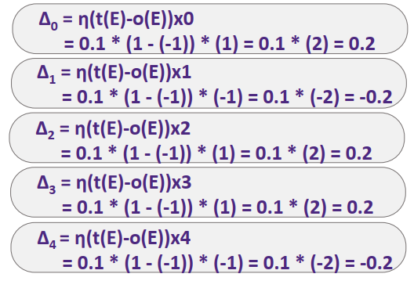
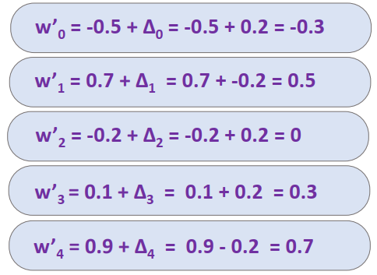
Calculating the error values
Calculating the New Weights
ɳ = 0.1

Slide 54
Updated look of Perceptron
Calculation with updated weights:
X₁ = -1, X₂ = 1, X₃ = 1, X₄ = -1
S= -0.3 + 0.5*(-1) + (0)* (1) + 0.3*(1) + 0.7* (-1) = -1.2
Still the answer is wrong but going closer to 0 ( from -2.2 to -1.2)
In few epochs this example will be correctly categorized
1
-0.3
If S > 0
+1
-1
x₁
0.5
S
0
ŷ
1
x₂
0.3
-1
1
x₃
0.7
-1
x₄

Slide 55
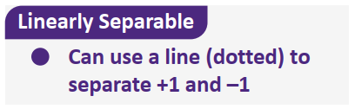
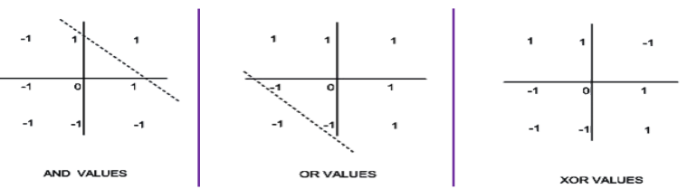
Limitations of Perceptron
Cannot learn some simple Boolean functions for example XOR
Can only learn linearly separable Boolean functions

Slide 56
Neural Networks
How can the neurons be clustered/connected together?
The structure used in these networks is a layering approach, hence the term – Multi-layered Neural Networks
These layers are connected to each other in a linear fashion.
We can make the system represent more complex functions by adding more layers.

Slide 57
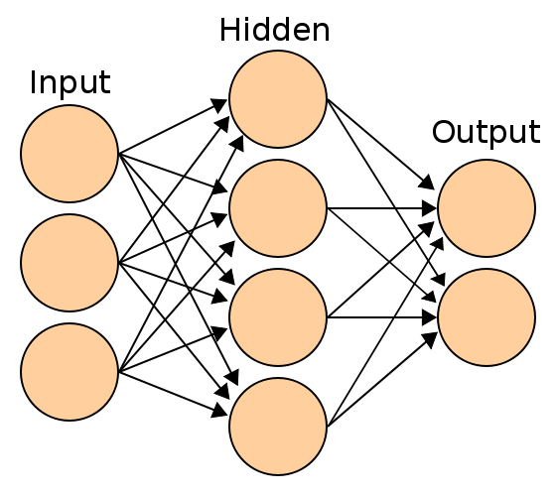
An example of a multi-layered NN

Slide 58
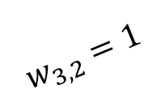

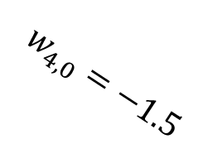
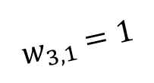


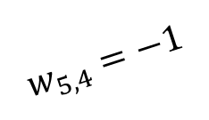
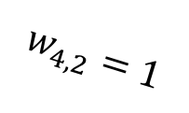
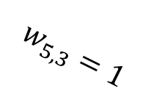
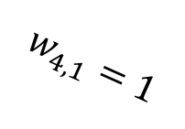
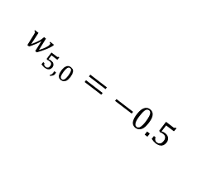
Our First Neural Network: XOR
A neural network is built using perceptrons as building blocks.
The inputs to some perceptrons are outputs of other perceptrons.
Here is an example neural network computing the XOR function.
$$w_{3,0}=−0.5$$
Unit 3
$$w_{3,1}=1$$
$$w_{5,0}=−0.5$$
$$w_{5,3}=1$$
$$w_{3,2}=1$$
Unit 5
Output:
$$x_{1}$$
$$w_{4,0}=−1.5$$
$$x_{2}$$
$$w_{4,1}=1$$
$$w_{5,4}=−1$$
Unit 4
$$w_{4,2}=1$$

Slide 59

Our First Neural Network: XOR
To simplify the picture, we do not show the bias input anymore.
We just show the bias weights $w_{j,0}$.
Besides the bias input, there are two inputs: $x_{1}$, $x_{2}$.
$$w_{3,0}=−0.5$$
Unit 3
$$w_{3,1}=1$$
$$w_{5,0}=−0.5$$
$$w_{5,3}=1$$
$$w_{3,2}=1$$
Unit 5
Output:
$$x_{1}$$
$$w_{4,0}=−1.5$$
$$x_{2}$$
$$w_{4,1}=1$$
$$w_{5,4}=−1$$
Unit 4
$$w_{4,2}=1$$

Slide 60
Our First Neural Network: XOR
The XOR network shows how individual perceptrons can be combined to perform more complicated functions.
$$w_{3,0}=−0.5$$
OR unit
$$w_{3,1}=1$$
$$w_{5,0}=−0.5$$
$$w_{5,3}=1$$
$$w_{3,2}=1$$
A AND (NOT B)
Output:
$$x_{1}$$
$$w_{4,0}=−1.5$$
$$x_{2}$$
$$w_{4,1}=1$$
$$w_{5,4}=−1$$
AND unit
$$w_{4,2}=1$$

Slide 61



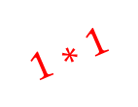
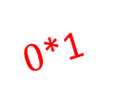
Computing the Output: An Example
Suppose that $x_{1}=0,x_{2}=1$ (corresponding to false XOR true).
For the OR unit:
The dot product is: $1∗(−0.5)+0∗1+1∗1=0.5$.
The activation function (assuming a step function) outputs 1.
$$1∗(−0.5)$$
OR unit
$$1$$
$$w_{5,0}=−0.5$$
$$w_{5,3}=1$$
$0$*1
A AND (NOT B)
Output:
$$x_{1}$$
$$1∗1$$
$$w_{4,0}=−1.5$$
$$x_{2}$$
$$w_{4,1}=1$$
$$w_{5,4}=−1$$
AND unit
$$w_{4,2}=1$$

Slide 62

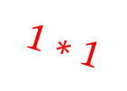
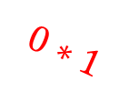

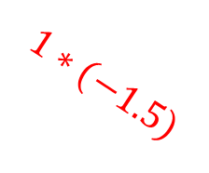
Computing the Output: An Example
Suppose that $x_{1}=0,x_{2}=1$ (corresponding to false XOR true).
For the AND unit:
The dot product is: $1∗\left(−1.5\right)+0∗1+1∗1=−0.5$.
The activation function (assuming a step function) outputs 0.
$$1∗(−0.5)$$
OR unit
$$1$$
$$w_{5,0}=−0.5$$
$$w_{5,3}=1$$
$0$*1
A AND (NOT B)
Output:
$$x_{1}$$
$$1∗1$$
$$1∗(−1.5)$$
$$x_{2}$$
$$0∗1$$
$$w_{5,4}=−1$$
AND unit
$$1∗1$$
$$0$$

Slide 63


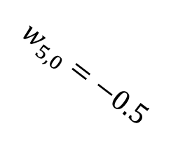

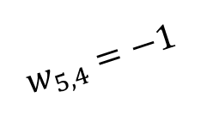

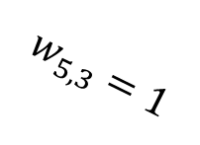
Computing the Output: An Example
Suppose that $x_{1}=0,x_{2}=$1 (corresponding to false XOR true).
For the output unit (computing the A AND (NOT B) function):
One input is the output of the OR unit, which is 1.
The other input is the output of the AND unit, which equals 0.
$$1∗(−0.5)$$
OR unit
$$1$$
$$w_{5,0}=−0.5$$
$$w_{5,3}=1$$
$0$*1
A AND (NOT B)
Output:
$$x_{1}$$
$$1∗1$$
$$1∗(−1.5)$$
$$x_{2}$$
$$0∗1$$
$$w_{5,4}=−1$$
AND unit
$$1∗1$$
$$0$$

Slide 64


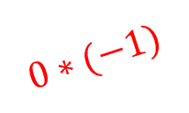
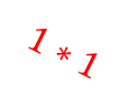
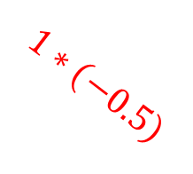
Computing the Output: An Example
Suppose that $x_{1}=0,x_{2}=$1 (corresponding to false XOR true).
For the output unit (computing the A AND (NOT B) function):
The dot product is: $1∗(−0.5)∗1+1∗1+1∗0=0.5$.
The activation function (assuming a step function) outputs 1.
$$1∗(−0.5)$$
OR unit
$$1∗(−0.5)$$
$$1∗1$$
$0$*1
A AND (NOT B)
Output:
$$x_{1}$$
$$1∗1$$
$$1$$
$$1∗(−1.5)$$
$$x_{2}$$
$$0∗1$$
$$0∗(−1)$$
AND unit
$$1∗1$$

Slide 65


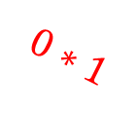
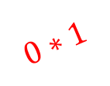
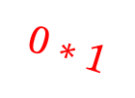
Verifying the XOR Network
We can follow the same process to compute the output of this network for the other three cases.
Here we consider the case where $x_{1}=0,x_{2}=0$ (corresponding to false XOR false).
The output is 0, as it should be.
$$1∗(−0.5)$$
OR unit
$$1∗(−0.5)$$
$$0∗1$$
$0$*1
A AND (NOT B)
Output:
$$x_{1}$$
$$0∗1$$
$$0$$
$$1∗(−1.5)$$
$$x_{2}$$
$$0∗1$$
$$0∗(−1)$$
AND unit
$$0∗1$$

Slide 66

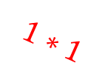
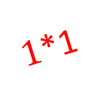
Verifying the XOR Network
We can follow the same process to compute the output of this network for the other three cases.
Here we consider the case where $x_{1}=1,x_{2}=0$ (corresponding to true XOR false).
The output is 1, as it should be.
$$1∗(−0.5)$$
OR unit
$$1∗(−0.5)$$
$$1∗1$$
$1$*1
A AND (NOT B)
Output:
$$x_{1}$$
$$0∗1$$
$$1$$
$$1∗(−1.5)$$
$$x_{2}$$
$$1∗1$$
$$0∗(−1)$$
AND unit
$$0∗1$$

Slide 67

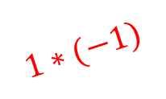

Verifying the XOR Network
We can follow the same process to compute the output of this network for the other three cases.
Here we consider the case where $x_{1}=1,x_{2}=1$ (corresponding to true XOR true).
The output is 0, as it should be.
$$1∗(−0.5)$$
OR unit
$$1∗(−0.5)$$
$$1∗1$$
$1$*1
A AND (NOT B)
Output:
$$x_{1}$$
$$1∗1$$
$$0$$
$$1∗(−1.5)$$
$$x_{2}$$
$$1∗1$$
$$1∗(−1)$$
AND unit
$$1∗1$$

Slide 68
Neural Networks
This neural network example consists of six units:
Three input units (including the not-shown bias input).
Three perceptrons.
Yes, in the notation we will be using, inputs count as units.
$$w_{3,0}=−0.5$$
Unit 3
$$w_{3,1}=1$$
$$w_{5,0}=−0.5$$
$$w_{5,3}=1$$
$$w_{3,2}=1$$
Unit 5
Output:
$$x_{1}$$
$$w_{4,0}=−1.5$$
$$x_{2}$$
$$w_{4,1}=1$$
$$w_{5,4}=−1$$
Unit 4
$$w_{4,2}=1$$

Slide 69

Neural Networks
Weights are denoted as $w_{ji}$.
Weight $w_{ji}$ belongs to the edge that connects the output of unit $i$ with an input of unit $j$.
Units $0, 1, …,D$ are the input units (units 0, 1, 2 in this example).
$$w_{3,0}=−0.5$$
Unit 3
$$w_{3,1}=1$$
$$w_{5,0}=−0.5$$
$$w_{5,3}=1$$
$$w_{3,2}=1$$
Unit 5
Output:
$$x_{1}$$
$$w_{4,0}=−1.5$$
$$x_{2}$$
$$w_{4,1}=1$$
$$w_{5,4}=−1$$
Unit 4
$$w_{4,2}=1$$

Slide 70
Neural Network Layers
Oftentimes, Neural networks are organized into layers.
The input layer is the initial layer of input units (units 0, 1, 2 in our example).
The output layer is at the end (unit 5 in our example).
Zero, one or more hidden layers can be between the input and output layers.
$$w_{3,0}=−0.5$$
Unit 3
$$w_{3,1}=1$$
$$w_{5,0}=−0.5$$
$$w_{5,3}=1$$
$$w_{3,2}=1$$
Unit 5
Output:
$$x_{1}$$
$$w_{4,0}=−1.5$$
$$x_{2}$$
$$w_{4,1}=1$$
$$w_{5,4}=−1$$
Unit 4
$$w_{4,2}=1$$

Slide 71
Neural Network Layers
There is only one hidden layer in our example, containing units 3 and 4.
Each hidden layer's inputs (except bias inputs) are outputs from previous layer.
Each hidden layer's outputs are inputs to the next layer.
The first hidden layer's inputs come from the input layer.
The last hidden layer's outputs are inputs to the output layer.
$$w_{3,0}=−0.5$$
Unit 3
$$w_{3,1}=1$$
$$w_{5,0}=−0.5$$
$$w_{5,3}=1$$
$$w_{3,2}=1$$
Unit 5
Output:
$$x_{1}$$
$$w_{4,0}=−1.5$$
$$x_{2}$$
$$w_{4,1}=1$$
$$w_{5,4}=−1$$
Unit 4
$$w_{4,2}=1$$

Slide 72
Feedforward Networks
Feedforward networks are networks where there are no directed loops.
While there are varieties of neural networks that are not feedforward or layered, our main focus will be layered feedforward networks.
$$w_{3,0}=−0.5$$
Unit 3
$$w_{3,1}=1$$
$$w_{5,0}=−0.5$$
$$w_{5,3}=1$$
$$w_{3,2}=1$$
Unit 5
Output:
$$x_{1}$$
$$w_{4,0}=−1.5$$
$$x_{2}$$
$$w_{4,1}=1$$
$$w_{5,4}=−1$$
Unit 4
$$w_{4,2}=1$$

Slide 73
What Neural Networks Can Compute
An individual perceptron is a linear classifier.
The weights of the perceptron define a linear boundary between two classes.
Layered feedforward neural networks with multiple hidden layers can compute any (linear/non-linear) mathematical function.
Another example of multi-class classification is shown on the next slide.

Slide 74
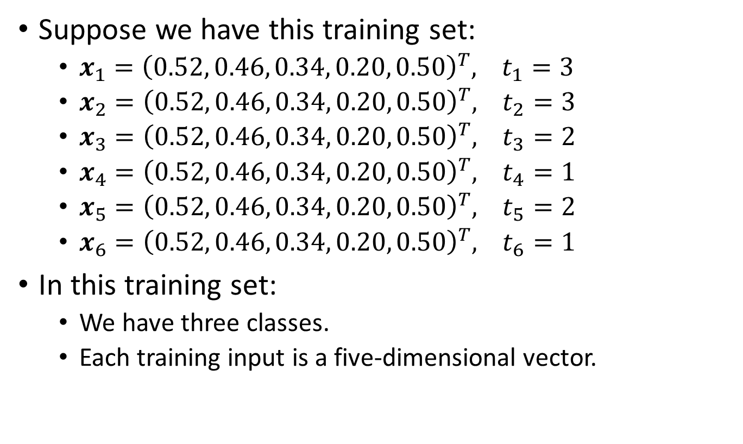
A Multiclass Example
Suppose we have this training set:
$x_{1}={\left(0.52, 0.46, 0.34, 0.20, 0.50\right)}^{T}, t_{1}=3$
$x_{2}={\left(0.52, 0.46, 0.34, 0.20, 0.50\right)}^{T}, t_{2}=3$
$x_{3}={\left(0.52, 0.46, 0.34, 0.20, 0.50\right)}^{T}, t_{3}=2$
$x_{4}={\left(0.52, 0.46, 0.34, 0.20, 0.50\right)}^{T}, t_{4}=1$
$x_{5}={\left(0.52, 0.46, 0.34, 0.20, 0.50\right)}^{T}, t_{5}=2$
$x_{6}={\left(0.52, 0.46, 0.34, 0.20, 0.50\right)}^{T}, t_{6}=1$
In this training set:
We have three classes.
Each training input is a five-dimensional vector.

Slide 75
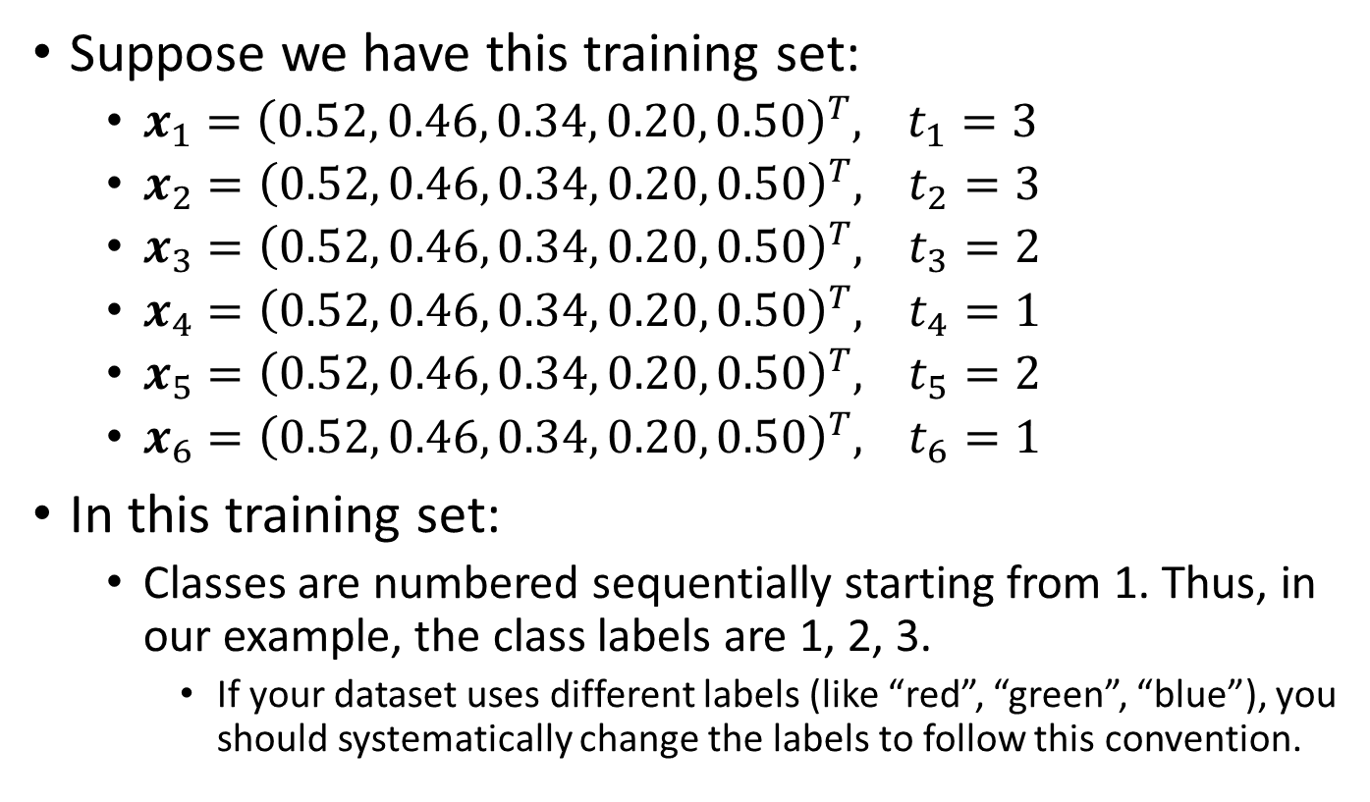
A Multiclass Example
Suppose we have this training set:
$x_{1}={\left(0.52, 0.46, 0.34, 0.20, 0.50\right)}^{T}, t_{1}=3$
$x_{2}={\left(0.52, 0.46, 0.34, 0.20, 0.50\right)}^{T}, t_{2}=3$
$x_{3}={\left(0.52, 0.46, 0.34, 0.20, 0.50\right)}^{T}, t_{3}=2$
$x_{4}={\left(0.52, 0.46, 0.34, 0.20, 0.50\right)}^{T}, t_{4}=1$
$x_{5}={\left(0.52, 0.46, 0.34, 0.20, 0.50\right)}^{T}, t_{5}=2$
$x_{6}={\left(0.52, 0.46, 0.34, 0.20, 0.50\right)}^{T}, t_{6}=1$
In this training set:
Classes are numbered sequentially starting from 1. Thus, in our example, the class labels are 1, 2, 3.
If your dataset uses different labels (like “red”, “green”, “blue”), you should systematically change the labels to follow this convention.

Slide 76
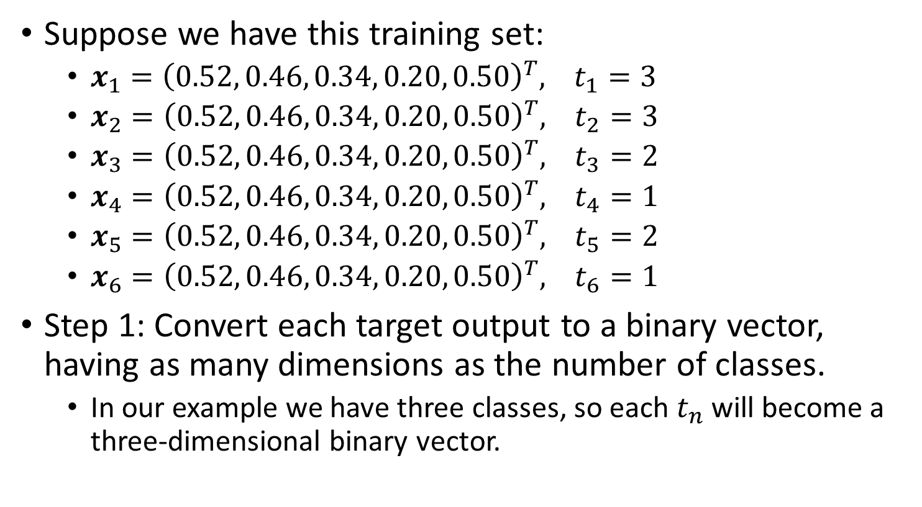
Converting to One-Versus-All
Suppose we have this training set:
$x_{1}={\left(0.52, 0.46, 0.34, 0.20, 0.50\right)}^{T}, t_{1}=3$
$x_{2}={\left(0.52, 0.46, 0.34, 0.20, 0.50\right)}^{T}, t_{2}=3$
$x_{3}={\left(0.52, 0.46, 0.34, 0.20, 0.50\right)}^{T}, t_{3}=2$
$x_{4}={\left(0.52, 0.46, 0.34, 0.20, 0.50\right)}^{T}, t_{4}=1$
$x_{5}={\left(0.52, 0.46, 0.34, 0.20, 0.50\right)}^{T}, t_{5}=2$
$x_{6}={\left(0.52, 0.46, 0.34, 0.20, 0.50\right)}^{T}, t_{6}=1$
Step 1: Convert each target output to a binary vector, having as many dimensions as the number of classes.
In our example we have three classes, so each $t_{n}$ will become a three-dimensional binary vector.

Slide 77
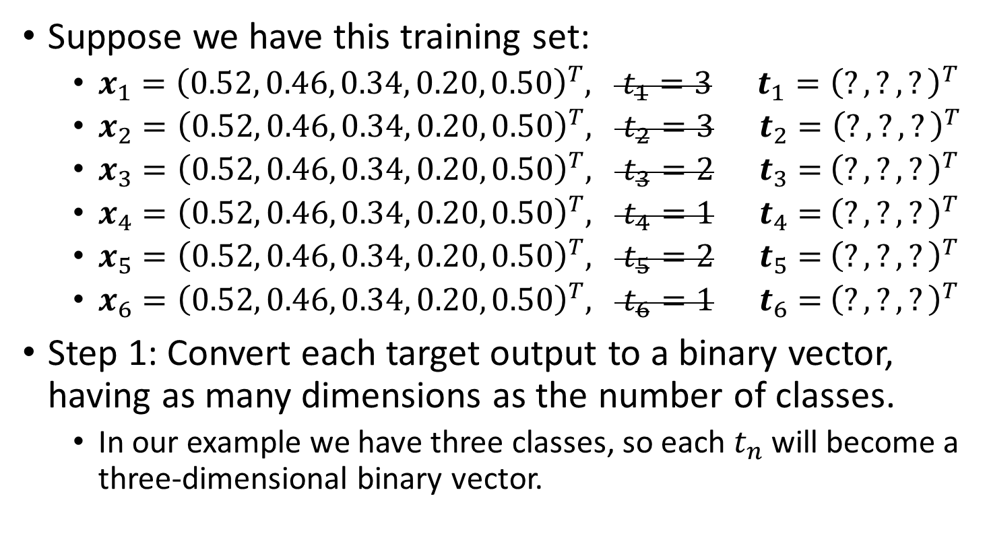
Converting to One-Versus-All
Suppose we have this training set:
$x_{1}={\left(0.52, 0.46, 0.34, 0.20, 0.50\right)}^{T}, t_{1}=3 t_{1}={\left(?, ?, ?\right)}^{T}$
$x_{2}={\left(0.52, 0.46, 0.34, 0.20, 0.50\right)}^{T}, t_{2}=3 t_{2}={\left(?, ?, ?\right)}^{T}$
$x_{3}={\left(0.52, 0.46, 0.34, 0.20, 0.50\right)}^{T}, t_{3}=2 t_{3}={ \left(?, ?, ?\right)}^{T}$
$x_{4}={\left(0.52, 0.46, 0.34, 0.20, 0.50\right)}^{T}, t_{4}=1 t_{4}={ \left(?, ?, ?\right)}^{T}$
$x_{5}={\left(0.52, 0.46, 0.34, 0.20, 0.50\right)}^{T}, t_{5}=2 t_{5}={ \left(?, ?, ?\right)}^{T}$
$x_{6}={\left(0.52, 0.46, 0.34, 0.20, 0.50\right)}^{T}, t_{6}=1 t_{6}={ \left(?, ?, ?\right)}^{T}$
Step 1: Convert each target output to a binary vector, having as many dimensions as the number of classes.
In our example we have three classes, so each $t_{n}$ will become a three-dimensional binary vector.

Slide 78
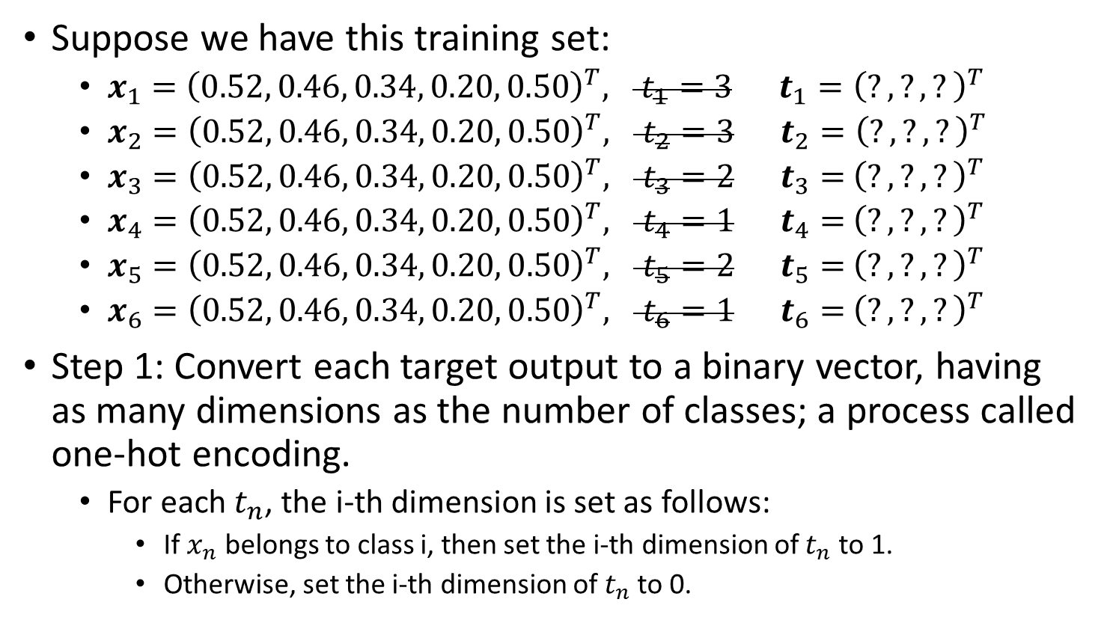
Converting to One-Versus-All
Suppose we have this training set:
$x_{1}={\left(0.52, 0.46, 0.34, 0.20, 0.50\right)}^{T}, t_{1}=3 t_{1}={\left(?, ?, ?\right)}^{T}$
$x_{2}={\left(0.52, 0.46, 0.34, 0.20, 0.50\right)}^{T}, t_{2}=3 t_{2}={\left(?, ?, ?\right)}^{T}$
$x_{3}={\left(0.52, 0.46, 0.34, 0.20, 0.50\right)}^{T}, t_{3}=2 t_{3}={ \left(?, ?, ?\right)}^{T}$
$x_{4}={\left(0.52, 0.46, 0.34, 0.20, 0.50\right)}^{T}, t_{4}=1 t_{4}={ \left(?, ?, ?\right)}^{T}$
$x_{5}={\left(0.52, 0.46, 0.34, 0.20, 0.50\right)}^{T}, t_{5}=2 t_{5}={ \left(?, ?, ?\right)}^{T}$
$x_{6}={\left(0.52, 0.46, 0.34, 0.20, 0.50\right)}^{T}, t_{6}=1 t_{6}={ \left(?, ?, ?\right)}^{T}$
Step 1: Convert each target output to a binary vector, having as many dimensions as the number of classes; a process called one-hot encoding.
For each $t_{n}$, the i-th dimension is set as follows:
If $x_{n}$ belongs to class i, then set the i-th dimension of $t_{n}$ to 1.
Otherwise, set the i-th dimension of $t_{n}$ to 0.

Slide 79
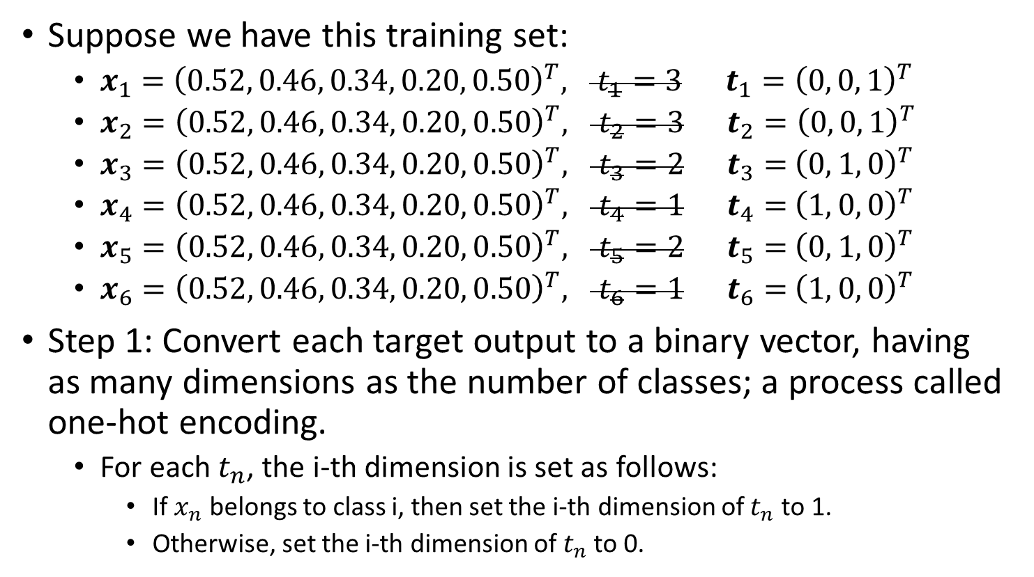
Converting to One-Versus-All
Suppose we have this training set:
$x_{1}={\left(0.52, 0.46, 0.34, 0.20, 0.50\right)}^{T}, t_{1}=3 t_{1}={\left(0, 0, 1\right)}^{T}$
$x_{2}={\left(0.52, 0.46, 0.34, 0.20, 0.50\right)}^{T}, t_{2}=3 t_{2}={\left(0, 0, 1\right)}^{T}$
$x_{3}={\left(0.52, 0.46, 0.34, 0.20, 0.50\right)}^{T}, t_{3}=2 t_{3}={ \left(0, 1, 0\right)}^{T}$
$x_{4}={\left(0.52, 0.46, 0.34, 0.20, 0.50\right)}^{T}, t_{4}=1 t_{4}={ \left(1, 0, 0\right)}^{T}$
$x_{5}={\left(0.52, 0.46, 0.34, 0.20, 0.50\right)}^{T}, t_{5}=2 t_{5}={ \left(0, 1, 0\right)}^{T}$
$x_{6}={\left(0.52, 0.46, 0.34, 0.20, 0.50\right)}^{T}, t_{6}=1 t_{6}={ \left(1, 0, 0\right)}^{T}$
Step 1: Convert each target output to a binary vector, having as many dimensions as the number of classes; a process called one-hot encoding.
For each $t_{n}$, the i-th dimension is set as follows:
If $x_{n}$ belongs to class i, then set the i-th dimension of $t_{n}$ to 1.
Otherwise, set the i-th dimension of $t_{n}$ to 0.

Slide 80
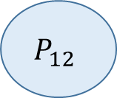
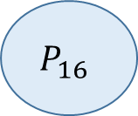
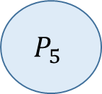













A possible Network for Our Example
Input layer
Hidden Layer 1
Hidden Layer 2
Output layer
$$P_{1}$$
$$P_{6}$$
$$P_{10}$$
$$P_{14}$$
$$P_{2}$$
$$P_{7}$$
$$P_{11}$$
$$P_{3}$$
$$P_{15}$$
$$P_{8}$$
$$P_{12}$$
$$P_{4}$$
$$P_{9}$$
$$P_{13}$$
$$P_{16}$$
$$P_{5}$$

Slide 81
Note: There is also a bias input unit $P_{0}$, not shown here for simplicity.
$$P_{1}$$
$$P_{6}$$
$$P_{10}$$
$$P_{14}$$
$$P_{2}$$
$$P_{7}$$
$$P_{11}$$
$$P_{3}$$
$$P_{15}$$
$$P_{8}$$
$$P_{12}$$
$$P_{4}$$
$$P_{9}$$
$$P_{13}$$
$$P_{16}$$
$$P_{5}$$

Slide 82
Input Layer:
In our example, it must have five units, because each training input is five-dimensional.
$$P_{1}$$
$$P_{6}$$
$$P_{10}$$
$$P_{14}$$
$$P_{2}$$
$$P_{7}$$
$$P_{11}$$
$$P_{3}$$
$$P_{15}$$
$$P_{8}$$
$$P_{12}$$
$$P_{4}$$
$$P_{9}$$
$$P_{13}$$
$$P_{16}$$
$$P_{5}$$

Slide 83
Hidden layers:
This network has two hidden layers, with four units per layer.
The number of hidden layers and the number of units per layer are hyperparameters, they can take different values.
$$P_{1}$$
$$P_{6}$$
$$P_{10}$$
$$P_{14}$$
$$P_{2}$$
$$P_{7}$$
$$P_{11}$$
$$P_{3}$$
$$P_{15}$$
$$P_{8}$$
$$P_{12}$$
$$P_{4}$$
$$P_{9}$$
$$P_{13}$$
$$P_{16}$$
$$P_{5}$$

Slide 84
Output layer:
In our example, it must have three units, because we want to recognize three different classes.
$$P_{1}$$
$$P_{6}$$
$$P_{10}$$
$$P_{14}$$
$$P_{2}$$
$$P_{7}$$
$$P_{11}$$
$$P_{3}$$
$$P_{15}$$
$$P_{8}$$
$$P_{12}$$
$$P_{4}$$
$$P_{9}$$
$$P_{13}$$
$$P_{16}$$
$$P_{5}$$

Slide 85
Training MLP
Training multi-layered ANN is done using an algorithm called the Backpropagation algorithm.
The backpropagation algorithm is like a “credit assignment problem”.
In the context of neural networks, the "credit assignment problem" refers to the challenge of determining which neurons (and their connections) in a neural network are responsible for errors in the output.
Essentially, it's about figuring out how much "credit" or "blame" each neuron should get for the network's successes and failures in its predictions.

Slide 86



Neural Network Layers
Consider the XOR network again:
Consider a wrong output is produced at unit 5, which is dependent on unit 3 and 4 outputs, as well as the corresponding weights.
Now, considering only ‘upper’ route (shown by dashed lines), the output of unit 3 also depends on $w_{3,1}$ and $w_{3,2}$.
$$w_{3,0}=−0.5$$
Unit 3
$$w_{3,1}=1$$
$$w_{5,0}=−0.5$$
$$w_{5,3}=1$$
$$w_{3,2}=1$$
Unit 5
Output:
$$x_{1}$$
$$w_{4,0}=−1.5$$
$$x_{2}$$
$$w_{4,1}=1$$
$$w_{5,4}=−1$$
Unit 4
$$w_{4,2}=1$$

Slide 87

Neural Network Layers
Consider the XOR network again:
Consider a wrong output is produced at unit 5, which is dependent on unit 3 and 4 outputs, as well as the corresponding weights.
This means the wrong output of unit 3 also depends on $w_{3,1}$ and $w_{3,2}$, so they should also be adjusted in the weight update process.
$$w_{3,0}=−0.5$$
Unit 3
$$w_{3,1}=1$$
$$w_{5,0}=−0.5$$
$$w_{5,3}=1$$
$$w_{3,2}=1$$
Unit 5
Output:
$$x_{1}$$
$$w_{4,0}=−1.5$$
$$x_{2}$$
$$w_{4,1}=1$$
$$w_{5,4}=−1$$
Unit 4
$$w_{4,2}=1$$

Slide 88
Neural Network Layers
Consider the XOR network again:
Consider a wrong output is produced at unit 5, which is dependent on unit 3 and 4 outputs, as well as the corresponding weights.
Same is true for unit 4 as well.
$$w_{3,0}=−0.5$$
Unit 3
$$w_{3,1}=1$$
$$w_{5,0}=−0.5$$
$$w_{5,3}=1$$
$$w_{3,2}=1$$
Unit 5
Output:
$$x_{1}$$
$$w_{4,0}=−1.5$$
$$x_{2}$$
$$w_{4,1}=1$$
$$w_{5,4}=−1$$
Unit 4
$$w_{4,2}=1$$

Slide 89
Training MLP using Backpropagation
So, backpropagation helps to solve the credit assignment problem by determining how much each weight in the network contributed to the overall error and adjusting the weights accordingly.
This ensures that each weight is "credited" or "blamed" appropriately based on its impact on the network's performance, guiding the network to learn from its mistakes and improve its accuracy over time.
For more details:
https://www.youtube.com/watch?v=Ilg3gGewQ5U&ab_channel=3Blue1Brown

Slide 90
THANKS

